Slide 1
Character Class Victory Conditions in League of Legends
Ethan Swartzentruber 12/03/2019
Image Credit: Riot Games

Slide 2
Background
League of Legends is a 5v5 competitive strategy game
Each player chooses a character from a roster of 146 characters

Slide 3
Background
Riot Games defines 6 character classes
in their API:
Assassin
Fighter
Support
Mage
Marksman
Tank
Collectively called “objectives”
Several different types of advantage to be had:
Gold to buy items
Destroying Enemy Buildings
Experience Points
Killing neutral monsters
Image credit: League of Legends wiki, screenshots from game

Slide 4
Research Questions
How do the character classes pursue victory differently?
For which classes is it important to individually have an advantage, not just be on a team with an advantage?
To what extent is Riot’s division of the characters valid and useful?

Slide 5
Data
Gathered from Riot’s public API
Around 8000 games – limited by API rate limits :(
Lots of postgame stats, including ones used to denote “early game” advantage, which is usually thought to be more important for certain types of character

Slide 6
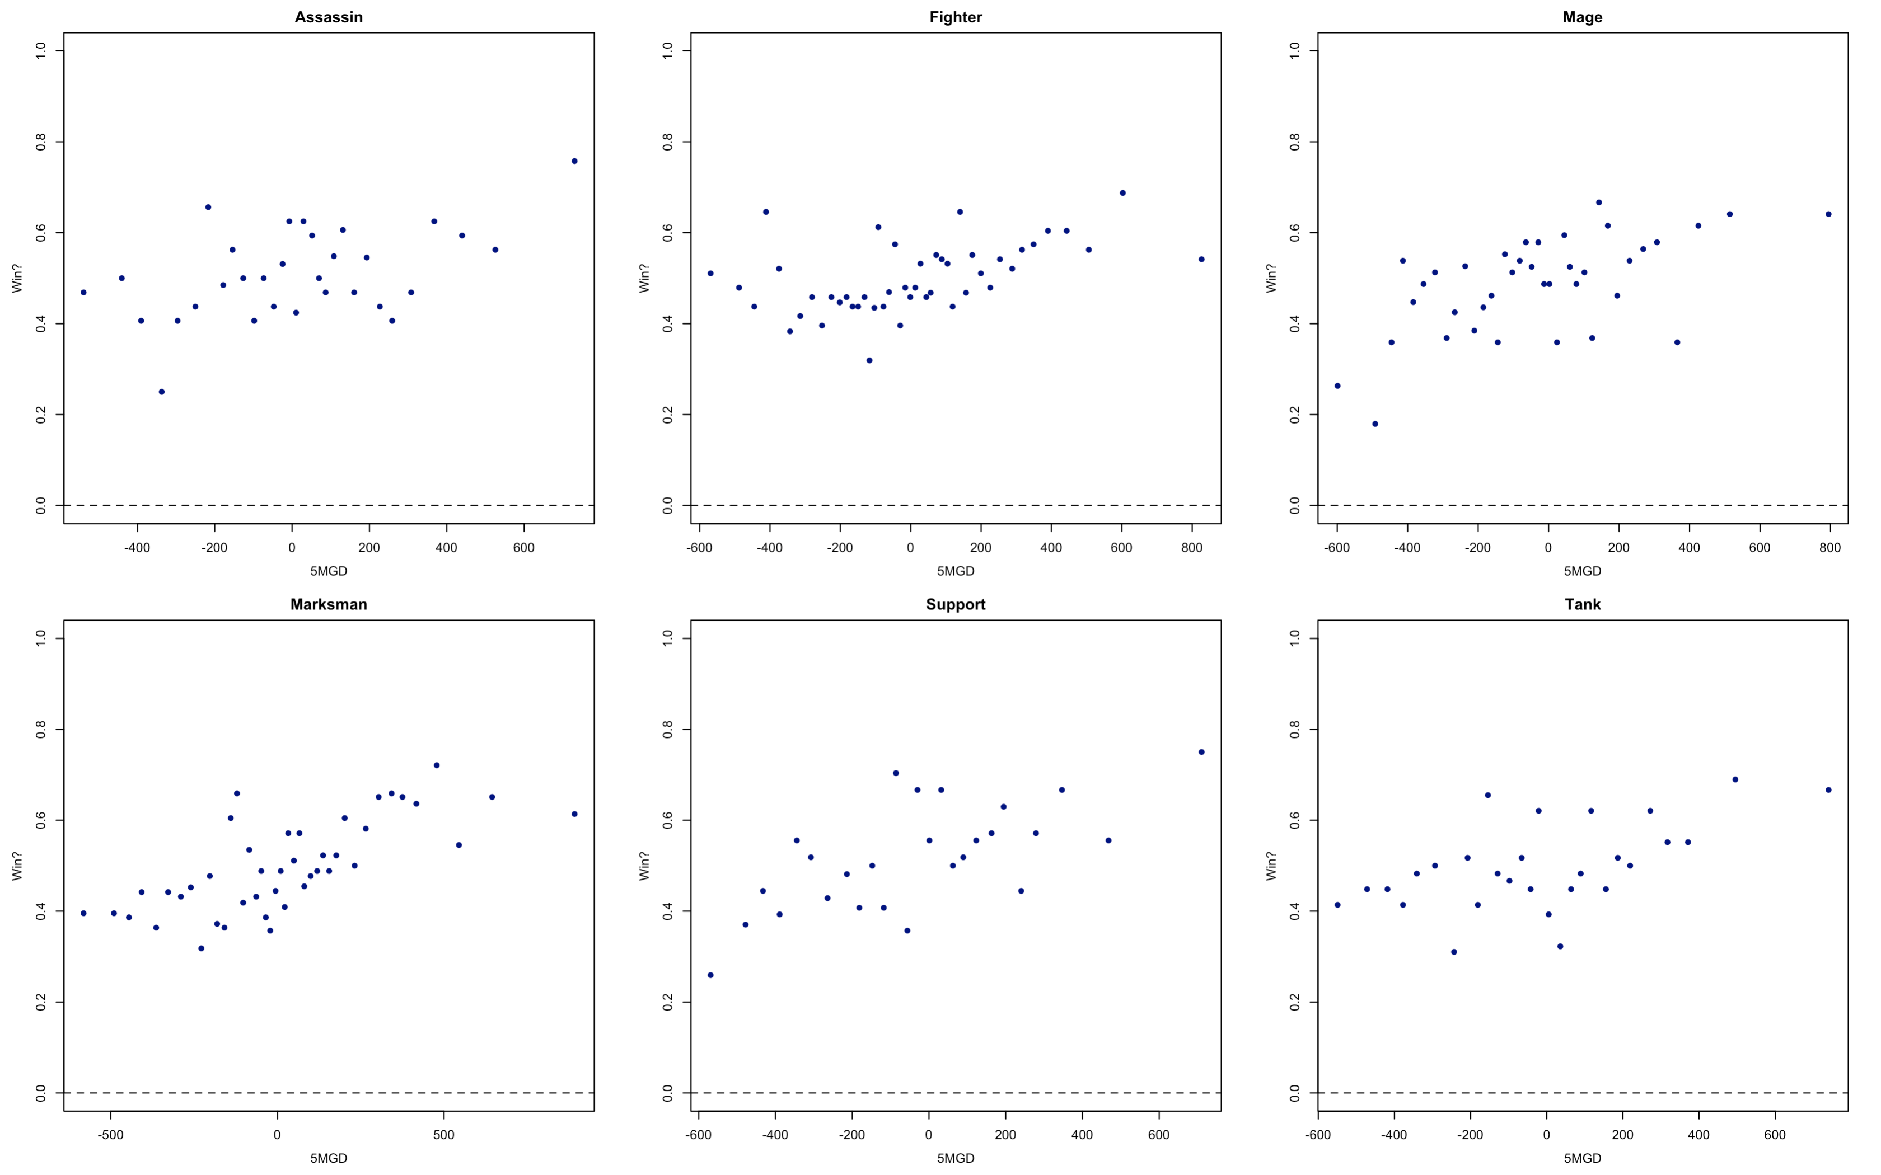
EDA

Slide 7
Modeling
Compared between several different stepwise techniques
Final model is from backwards selection with AIC
Some predictors from later in the game cause multicollinearity
Interestingly enough, interactions weren’t significant next to the main effects of the different advantages

Slide 8
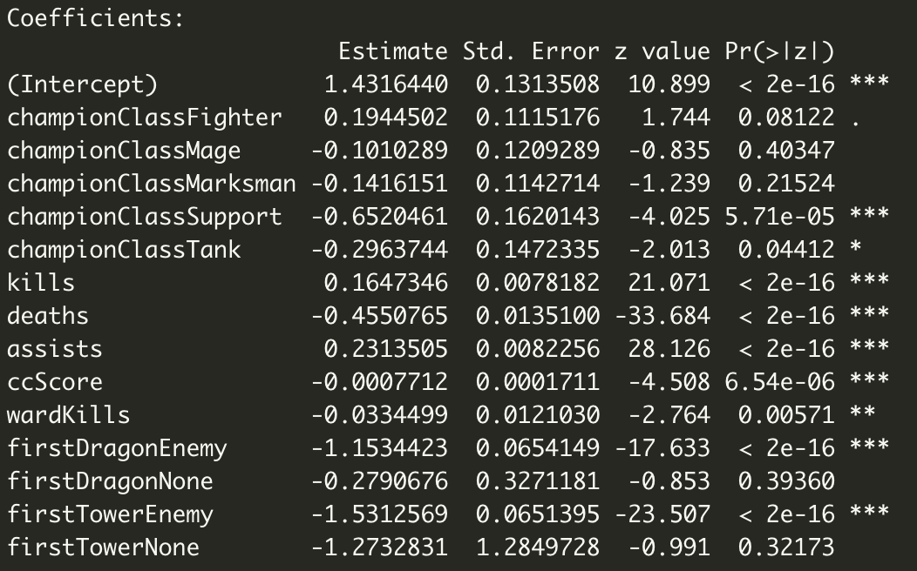
Results
Fighter class wins more often,
as done Assassin (baseline)
Could be related, although VIF was low
Assists higher magnitude
than kills
First dragon is important
First tower very important

Slide 9
Conclusions
Early objectives very important
In particular, more important than early individual advantage
Usefulness of early individual advantage did not vary significantly by champion class
Usefulness of early team advantage didn’t either
Riot’s division of the characters definitely has value in terms of distinguishing gameplay, but doesn’t really capture a difference in victory condition

